Slide 1

Sustainability

Slide 2
Contents
Introduction
Population
Ecosystem & Climate Change
Energy
Water & Agriculture
Environmental policies
Conclusion

Slide 3

Introduction

Slide 4
What is sustainability?
“development that meets the needs of present without compromising the ability of future generation to meet their own needs.”

Slide 5
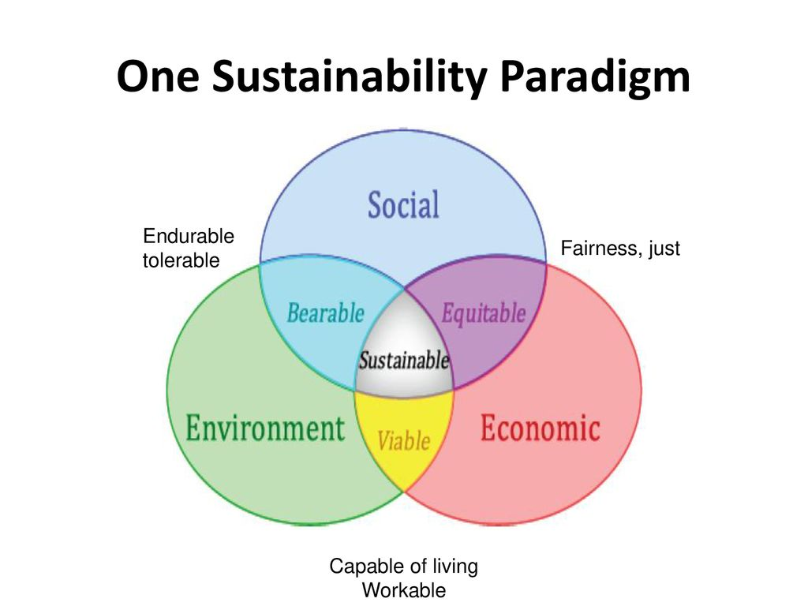

Slide 6
How do you determine sustainability?
There are two methods/ways to determine if we are headed towards sustainability-
IPAT Equation
Growth curves

Slide 7
The IPAT Equation
I = P * A* T
IPAT expresses a balance among interacting factors. I represent the impact of any given course on environment, P stands for human population, A stands for level of consumption per person and T is impact per unit of consumption. The equation is not meant to be mathematically rigorous, rather it provides a way of organizing the information.

Slide 8
Growth Curves
Growth curves shows us the past, present and future scenario of the population of a particular area. This does help us to determine if the place is headed towards a sustainable future or a destroyed one. There are basically two types of growth curves:
J Shaped Curve
S Shaped Curve

Slide 9
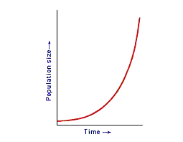
J-Curve

Slide 10
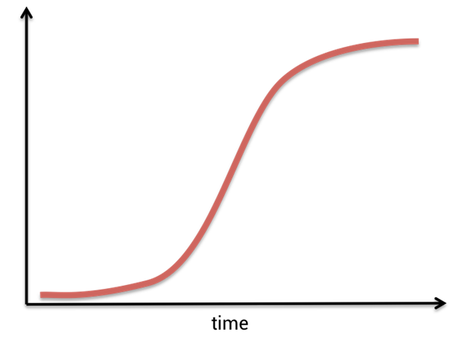
S-Curve
Population

Slide 11
Malthusian theory

Slide 12

Population

Slide 13
How to estimate future population?
There are basically many theories about this but we are focusing on two phenomena who are more promising:
Average Age
Human development(Specially women)

Slide 14
Average Age

Slide 15
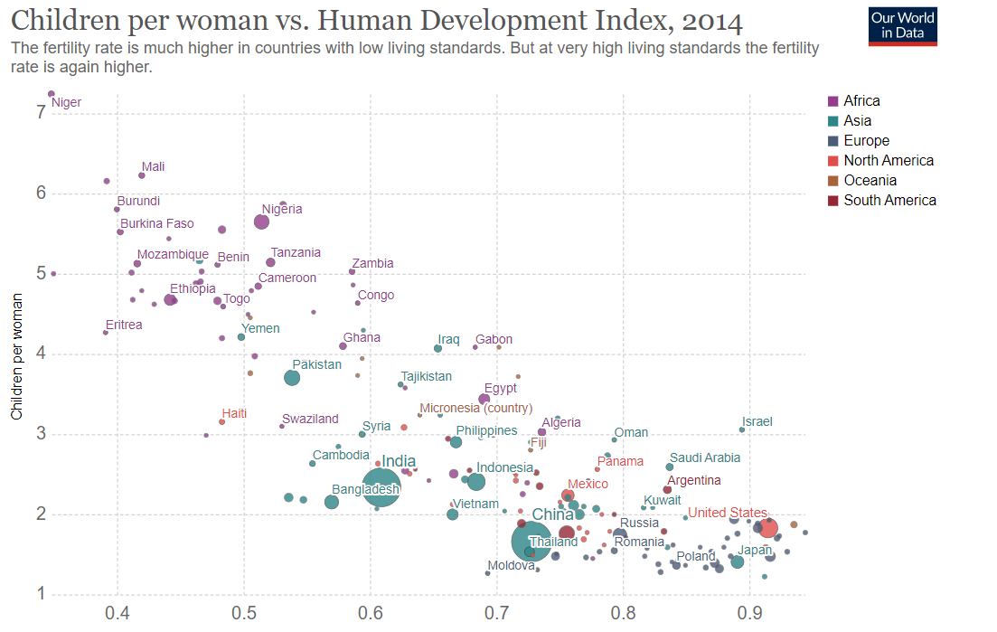
Human Development

Slide 16
Future Analysis(Pyramid Model)

Slide 17
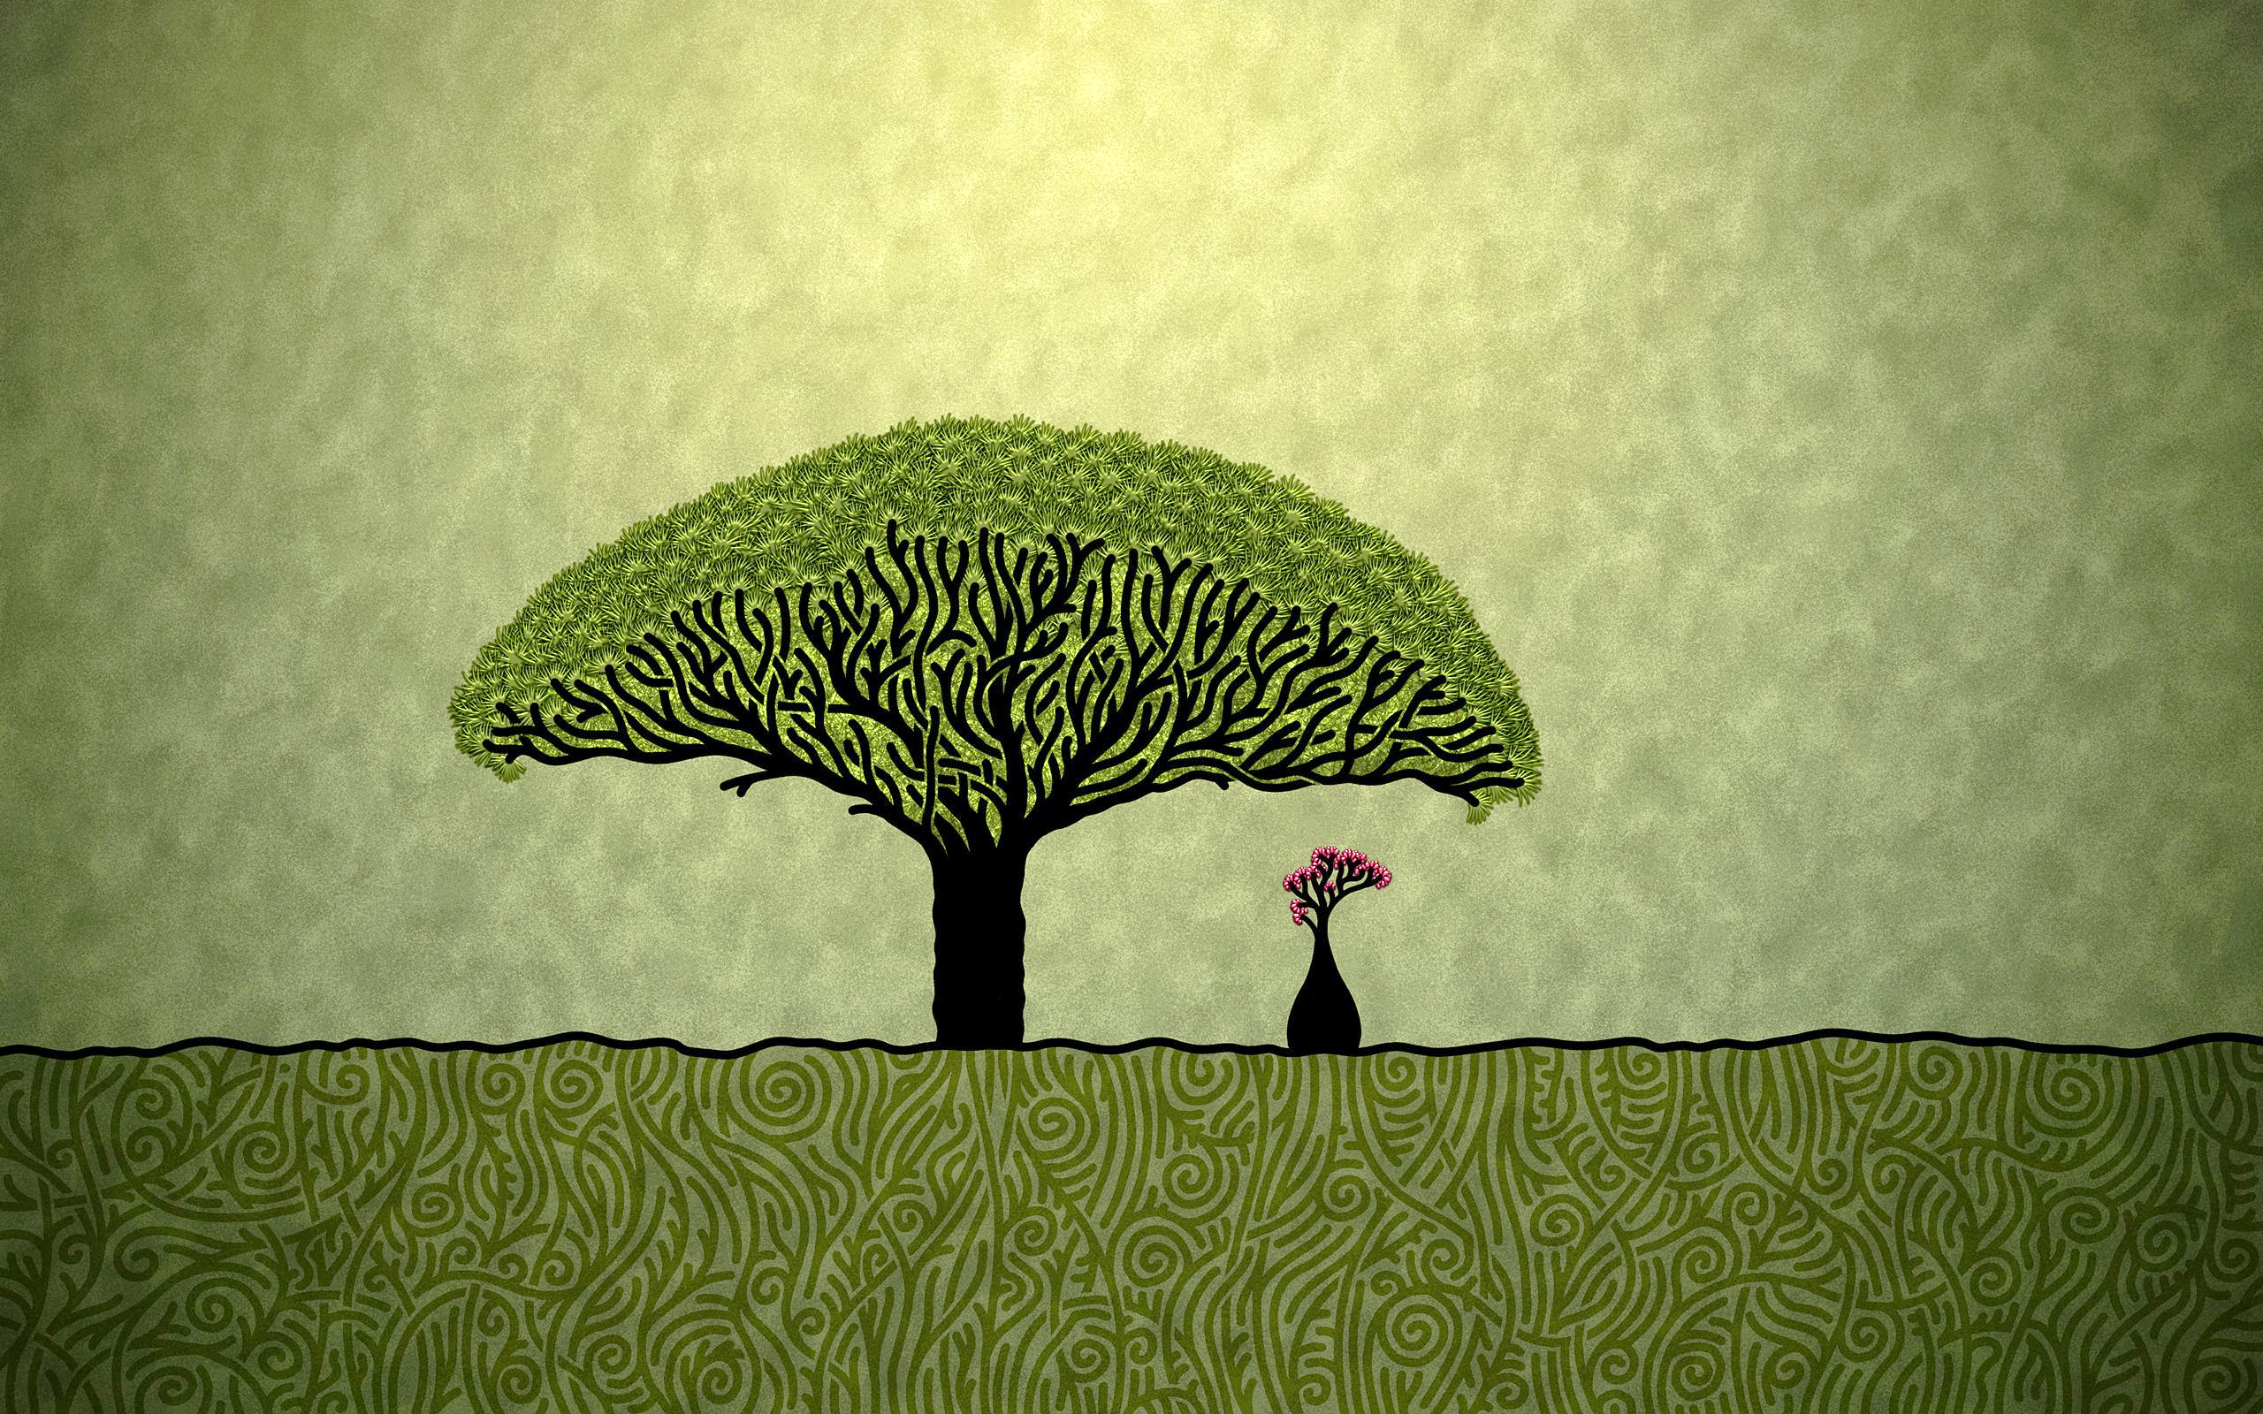
Ecosystem & Climate Change

Slide 18
Tragedy of the commons
Tragedy - an event causing great suffering
Commons - land or resources belonging to or affecting the whole of a community.
“Tragedy of the commons simply indicates to the destruction of common resources which is being done by human beings by misusing or overusing these resources.”

Slide 19
Solutions
Personal Action
Internal Governance
External Force

Slide 20
Climate vs. Weather
Climate
“Climate is the average daily weather for an extended period for a certain location ”
Weather
“Weather shows short term conditions of the atmosphere ”

Slide 21
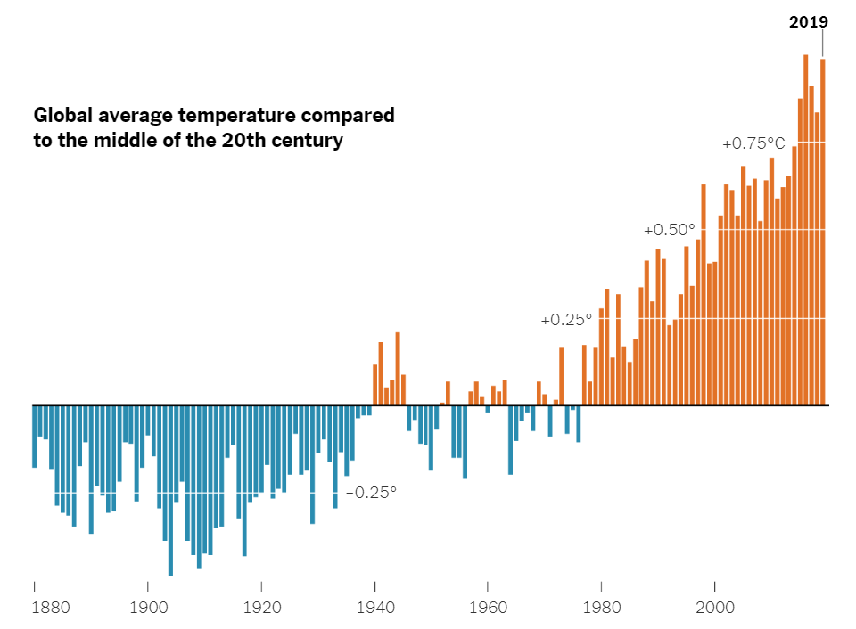
Modern Climate Changes

Slide 22
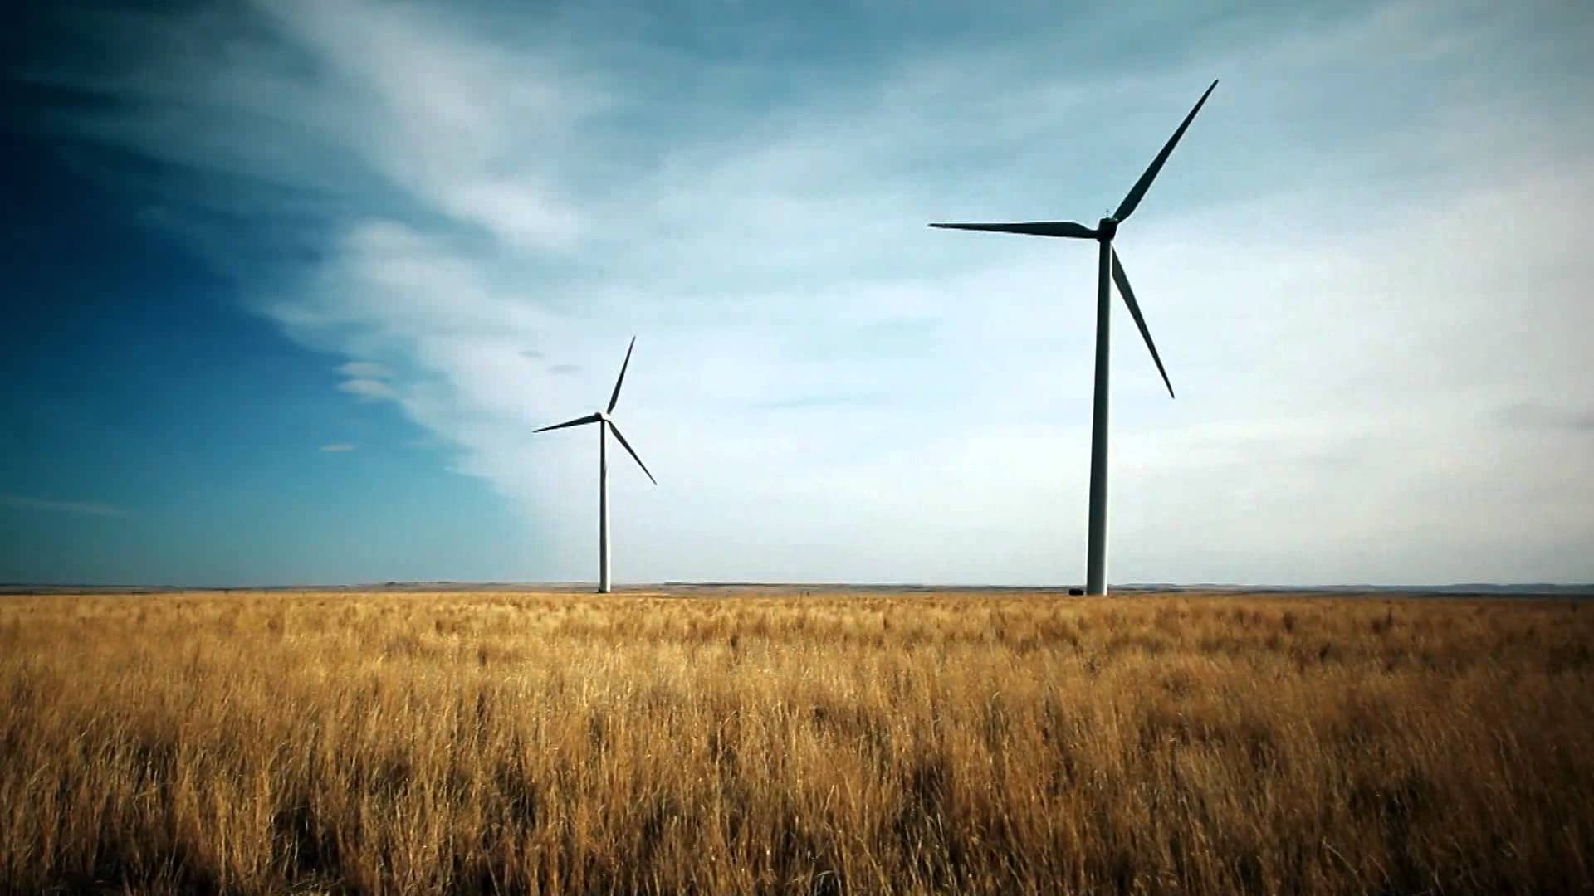
Energy

Slide 23
Energy Resources

Slide 24
Types of Energy Resources
There is not only one method to divide energy resources but the most appropriate one that suits the future divides these resources in two parts:
Renewable
Non-renewable

Slide 25
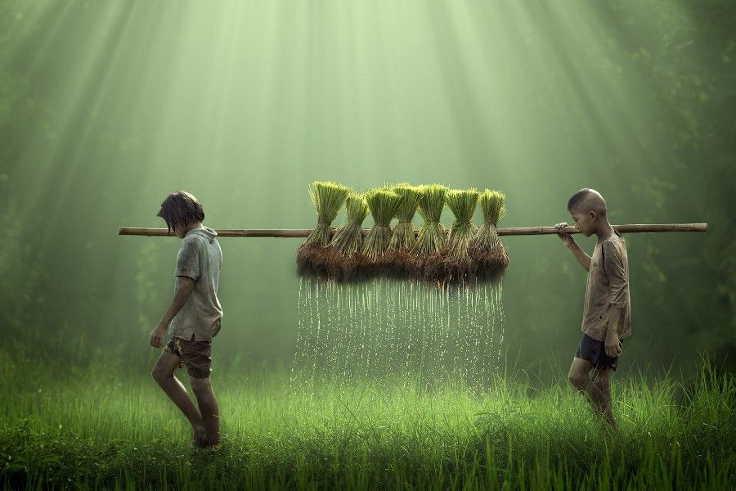
Water & Agriculture

Slide 26
Water (Ground Water)

Slide 27
Agriculture

Slide 28

Environmental Policies

Slide 29
“Good policies require natural understanding as well as social understanding”
There are two broad categories:
Command and Control
Market Incentive

Slide 30

Conclusion

Slide 31
Sustainable Future?

Slide 32
Thank You

